Slide 1
Comparative Analyis of
Transformer Models for
Sentiment Analysis
Final Presentation
Presented by: Team 1

Slide 2
TEAM MEMBERS
Jeshma Maria Veigas
1
Sanjal P S
2
Morla Jahnavi
3
Prajwal AN
4
Karan Pandey
5

Slide 3
Business Objective
Conduct a comparative analysis of different transformer models
(e.g., BERT, RoBERTa, DistilBERT, GPT-2, etc.) on sentiment
analysis.
The goal is to compare the performance, efficiency, and applicability of models to gain insights into their strength and weaknesses, selecting the most suitable solution for sentiment analysis.

Slide 4
Project Flow
Business Understanding
Data collection
EDA and Dataset Preparation
Model Implementation and Fine-Tuning
Model Evaluation and Comparative Analysis

Slide 5
Week 1: EDA & Dataset Preparation
Finalized Sentiment Analysis Task:
After discussion, sentiment analysis was chosen as the focus due to its relevance in real-world applications like product reviews and social media analysis.
Selected Transformer Models:
BERT, RoBERTa, DistilBERT and GPT-2 were selected for their proven effectiveness in NLP tasks.
Dataset Overview:
Downloaded the IMDB Movie Reviews Dataset, containing labeled positive and negative reviews.

Slide 6
Performed an initial exploration to understand class distribution and dataset size.
Data Cleaning:
Checked is their any duplicate and null entries.
Standardized text by lowercasing, removing special characters, and handling stop words.
Tokenization and Data Splitting:
Tokenized text data using Hugging Face’s tokenizer.
Split the dataset into training, validation, and test sets (e.g., 70%/15%/15%).

Slide 7
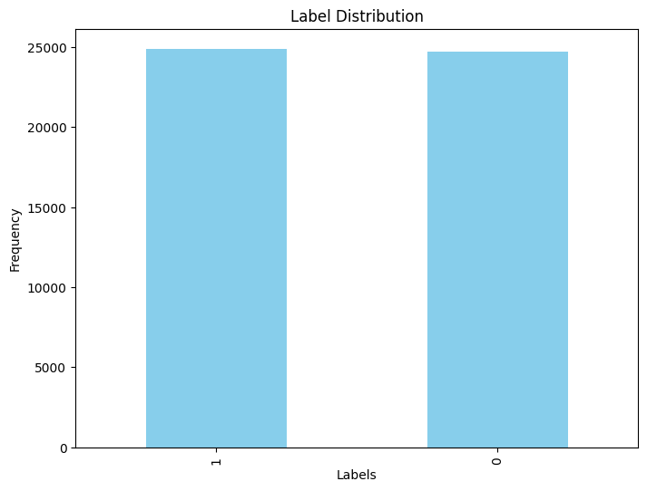
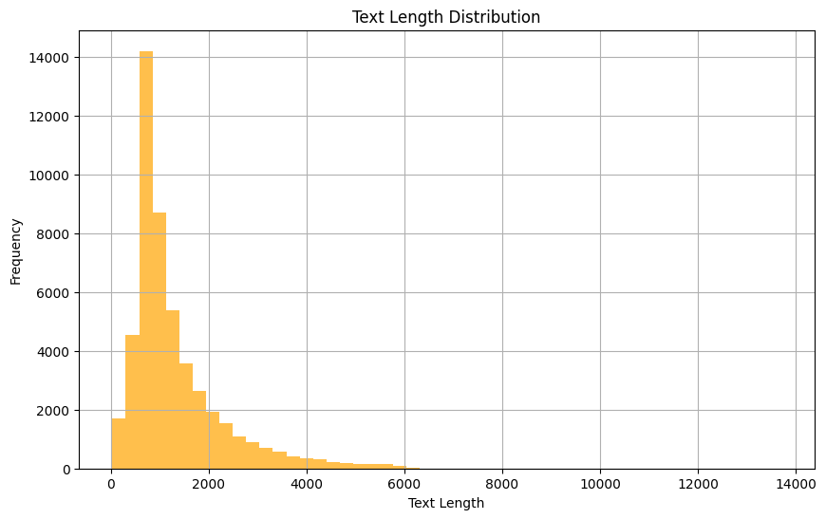
Figure 1. Label Distribution
Figure 2. Text length Distribution

Slide 8
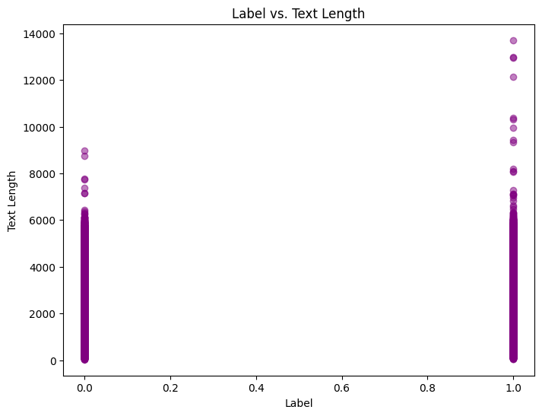
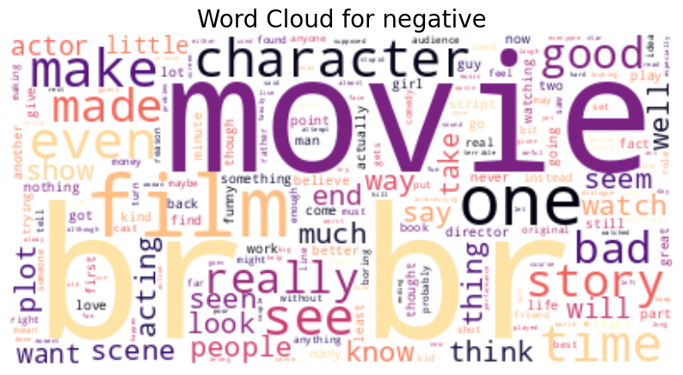
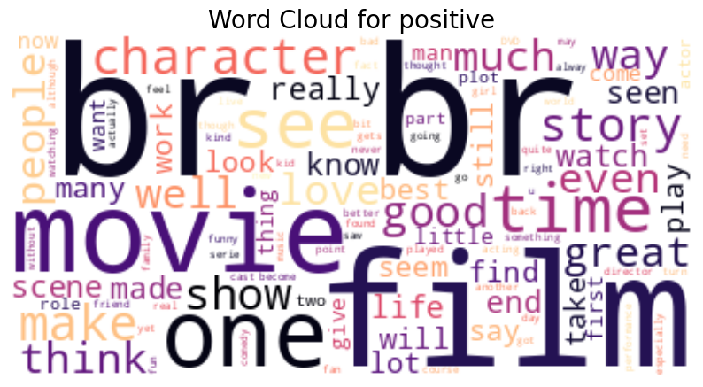
Figure 3. Correlation b/w Label vs Text Length
Figure 4. Word Cloud for Negative
Figure 5. Word Cloud for Positive

Slide 9
Week 2: Model Implementation & Fine-Tuning
Model Selection:
Selected pre-trained transformer models: BERT, RoBERTa, DistilBERT and GPT-2.
Loaded models and tokenizers using Hugging Face Transformers
Model Fine-Tuning:
Fine-tuned each model on the IMDB Movie Reviews dataset using pre-trained weights.
Utilized transfer learning to adapt models for the sentiment analysis task.

Slide 10
Hyperparameter Optimization:
Experimented with learning rates, batch sizes, and dropout rates.
Monitored loss and accuracy during training.
Training Setup:
Used PyTorch for model training.
Leveraged GPU acceleration for faster training.

Slide 11
Week 3:Evaluation and Comparative Analysis
Model Evaluation:
Evaluated models on the test dataset.
Computed key performance metrics: accuracy, F1-score, precision, and recall.
Computational Efficiency Analysis:
Measured training time, inference time, and memory usage.
Compared resource consumption across models.
Visualization and Reporting:
Created performance comparison plots.
Documented strengths and weaknesses of each model.

Slide 12
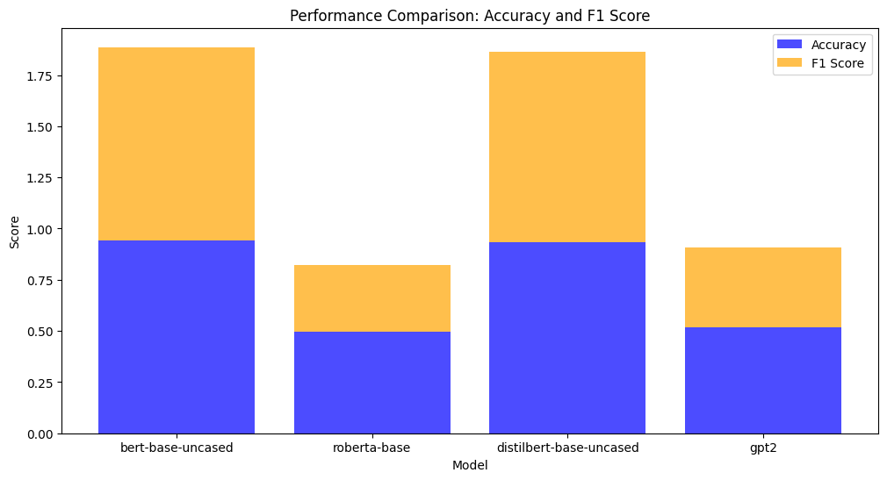
Figure 6. Performance Comparision

Slide 13
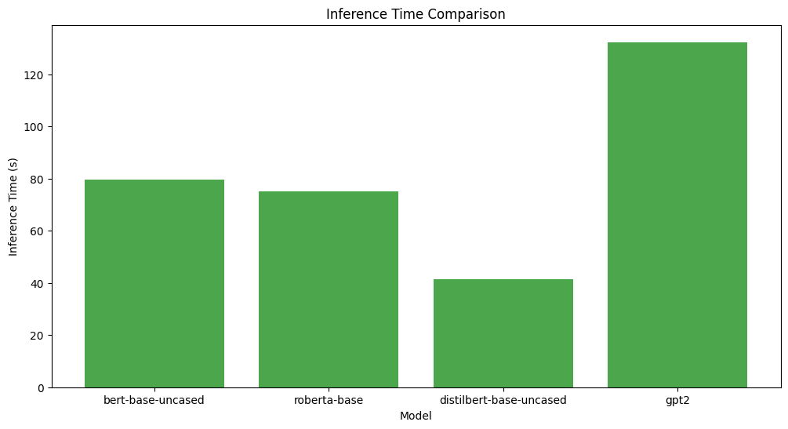
Figure 7. Inference Time Comparision

Slide 14
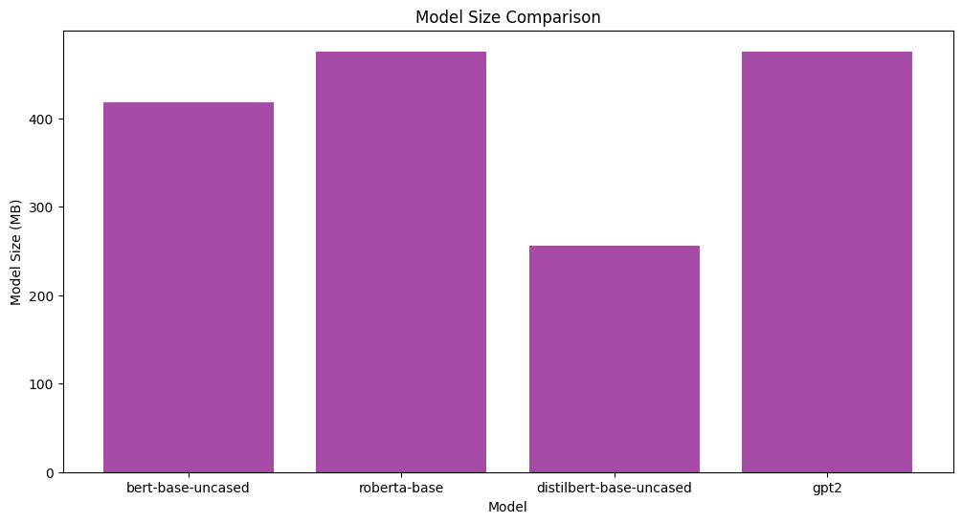
Figure 8. Model Size Comparision

Slide 15
CONCLUSION
BERT demonstrated strong performance and high accuracy for sentiment analysis tasks.
RoBERTa showed the lowest performance among the models analyzed.
DistilBERT provided strong performance but was slightly lower than BERT, with the added advantage of computational efficiency.
GPT-2, while effective, showed longer inference times compared to other models due to its generative nature.

Slide 16
THANK
YOU

